Slide 1

Mini-project midterm report- Problem A: Etcembly Ltd
Group 4 : shalomi FERNANDES; Fangnan Wei; Jiadong xu; Jiahui liu

Slide 2
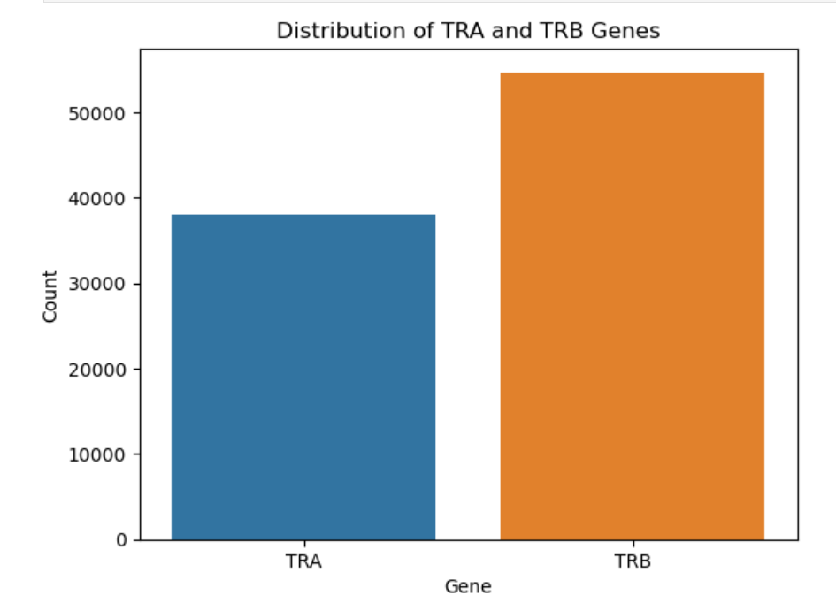
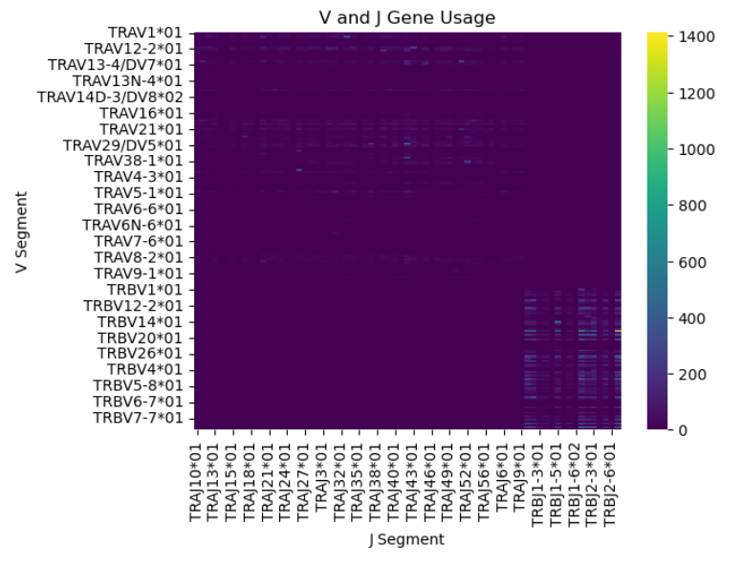
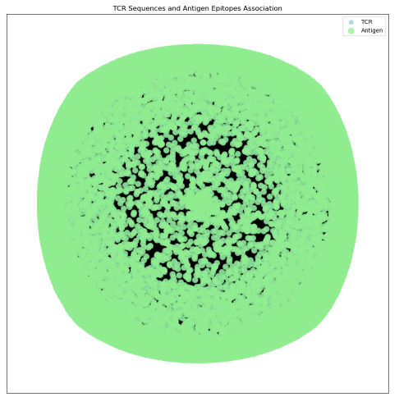
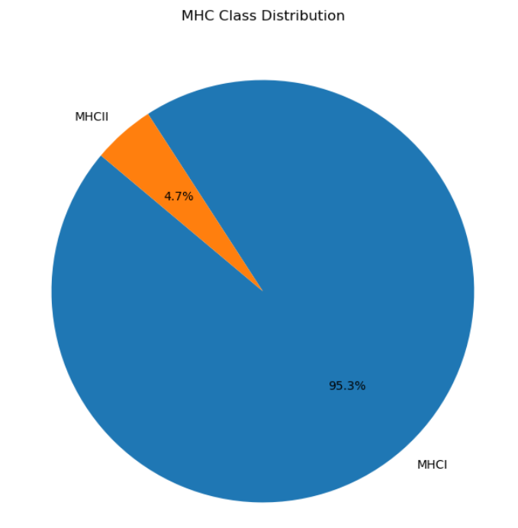
Understanding of the problem: what is INPUT and OUTPUT ：input is cdr3、v、j；output is epitope what columns we need: cdr3、v、j、 epitope; We are struggling with whether we need species and mhc.
Something to explain graphs

Slide 3
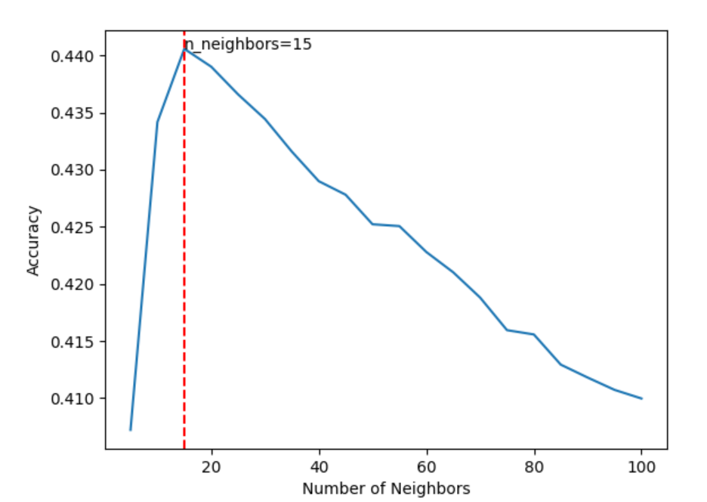
We Try to use K nearest neighbor(knn) for classification.
What is KNN? Why should we use KNN?
KNN relies on the distance measure in the feature space. If KNN can achieve good performance,
it means that the feature can represent the data point well.
What results we get by using KNN:
For KNN, n-neighbors=15 is the best result, accuracy = 0.4406; we use accuracy as a baseline and as a reference for subsequent methods.

Slide 4
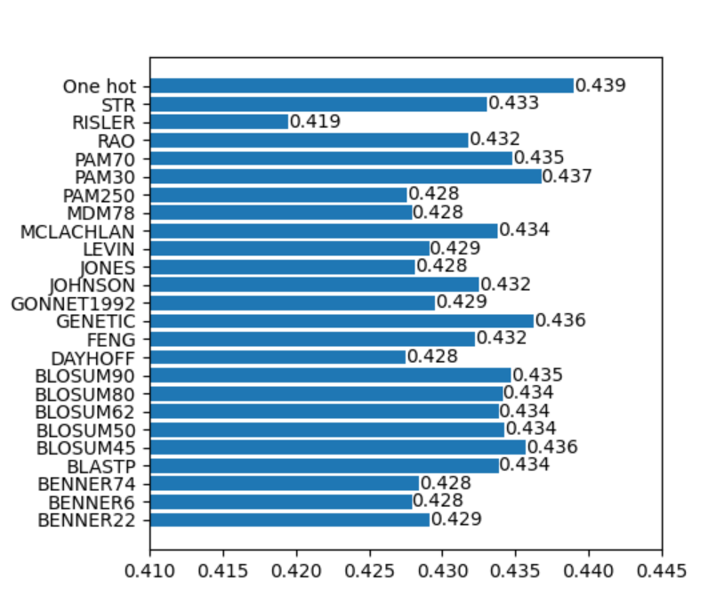
We Base on biological matrices and one-hot for encoding and comparison of knn accuracy, and we found that one-hot has the best effect.
We hope to compare the performance of different encoding methods in knn and compare which method has higher accuracy.

Slide 5
Things to focus on next and difficulties:
Things to focus on next:
We are exploring more encoding methods for V and J.
We may need a better way to calculate distance combining V, J and CDR3.
Difficulties:

Slide 6

Thanks

